Slide 1
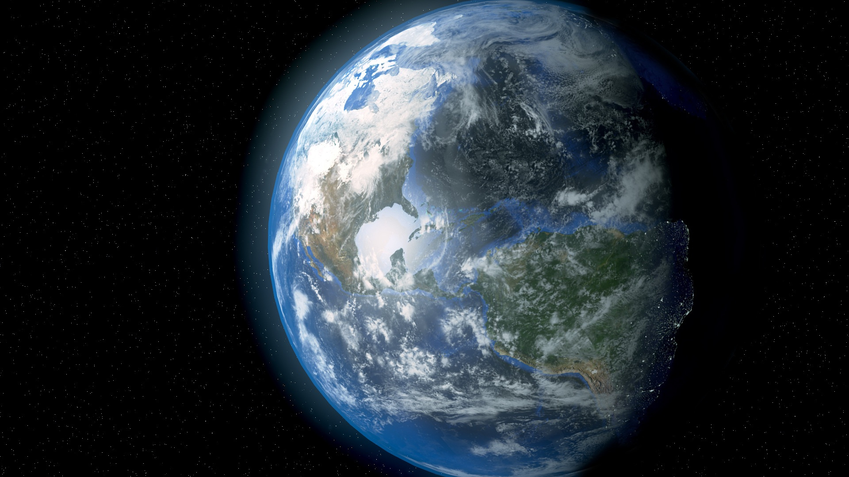


Meteor
Impact-Sim
Team: CLASHATHON
Members:
Ariel James Santiago
Joash Chrysler Aludino
Reign Justine Dela Paz
Kurt Marvic Amboy
Rex Gabriel Salamat
Elieser Agustin IV

Slide 2


Mission
To develop an intelligent simulation system that accurately models the effects of meteor impacts on Earth, providing valuable insights and visualizations that support scientific understanding, risk assessment, and informed decision-making in the face of potential threats.

Slide 3
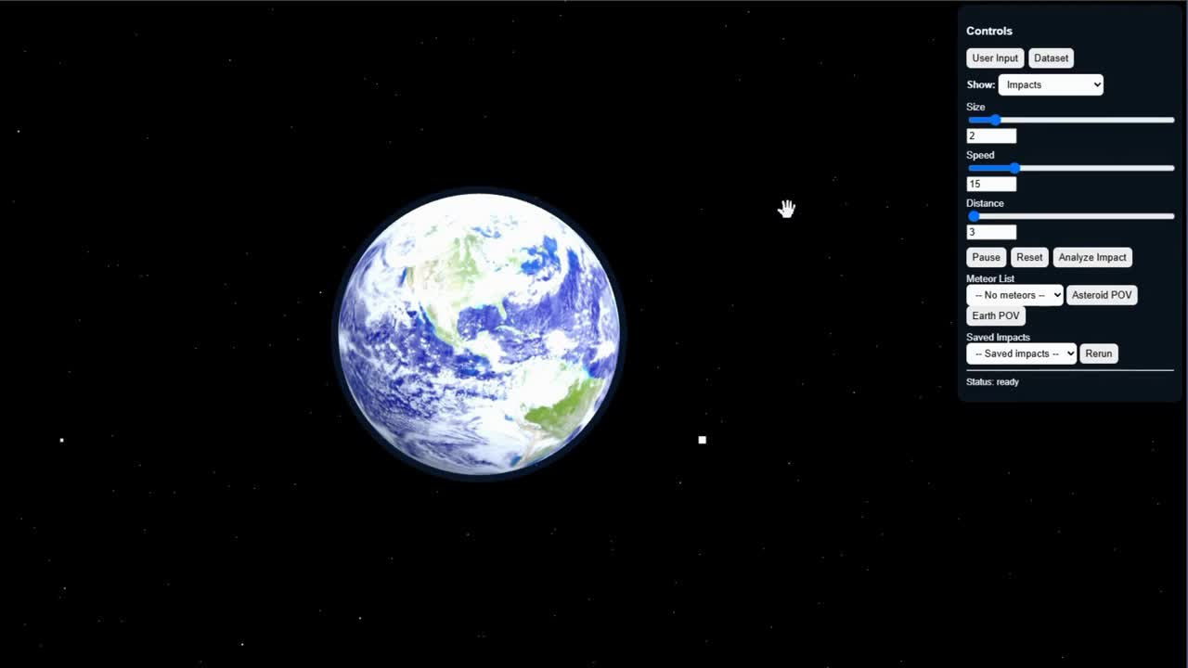
Demo Video

Slide 4


SUMMARY
WHAT?
WHY?
IMPORTANCE
The project is an Impact Simulation System that models and visualizes the potential effects of meteor impacts on Earth. It uses past data and user input to calculate and simulate the scale of destruction, affected geographical areas, and estimated casualties. The goal is to create an interactive tool that helps users understand the possible consequences of a meteor strike through data-driven simulation and visualization.
The project was developed to address the lack of accessible and accurate tools for studying and predicting meteor impact scenarios. Meteor strikes, while rare, can cause catastrophic damage if not properly understood or anticipated. The project aims to enhance understanding of meteor impacts, promote data-driven research in disaster risk assessment, and provide a technological foundation for future advancements in planetary defense and emergency preparedness.
Through this project, by simulating the scale of destruction, affected areas, and estimated casualties, the system provides valuable insights for scientists, emergency response teams, and government agencies. These insights enable decision-makers to develop effective disaster preparedness and mitigation strategies, including evacuation planning, early warning systems, and efficient resource allocation.

Slide 5
Resources & References
NASA Data & Resources
NASA Near-Earth Object (NEO) Web Service Application Programming Interface (API)
U.S. Geological Survey (USGS) National Earthquake Information Center (NEIC) Earthquake Catalog
Third Party Reference/Resource
ChatGPT (Code for Frontend & Backend | HTML, CSS - Frontend / Python, Javascript - Backend)

Slide 6

Thank
You!

